Slide 1
WORLD POPULATION INFERENCE

Slide 2
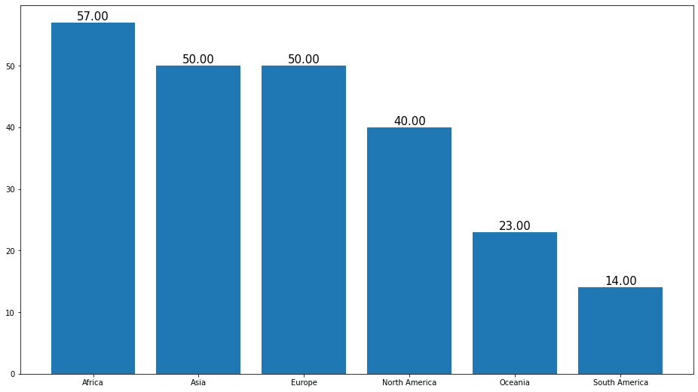
Number of countries by continent
Africa is having max entries of country records
South America is having least entries of country records

Slide 3
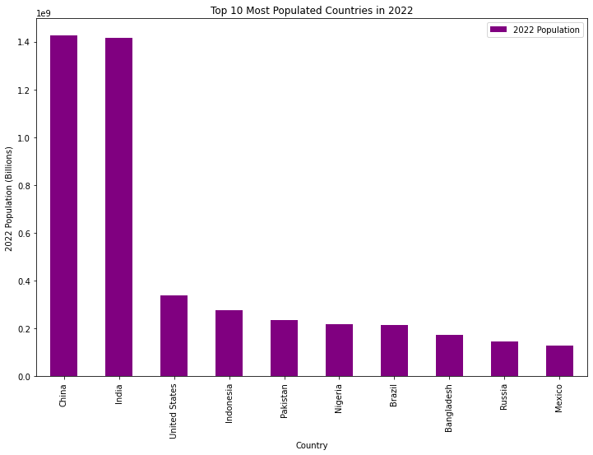
Top 10 Most Populated Countries in 2022
China is having max population of country records
Mexico is having least population of country records

Slide 4
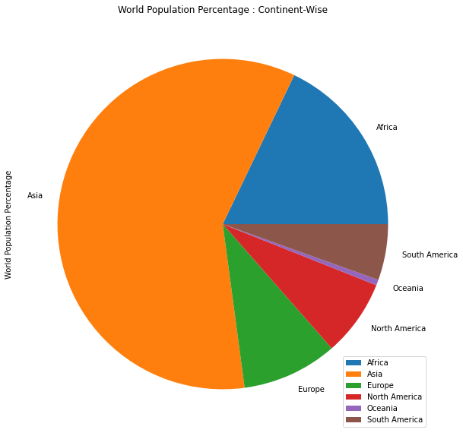
World Population Percentage : Continent-Wise
Asia is having maximum population
Africa is the second continent having the maximum population
Oceania is the least populated continent

Slide 5
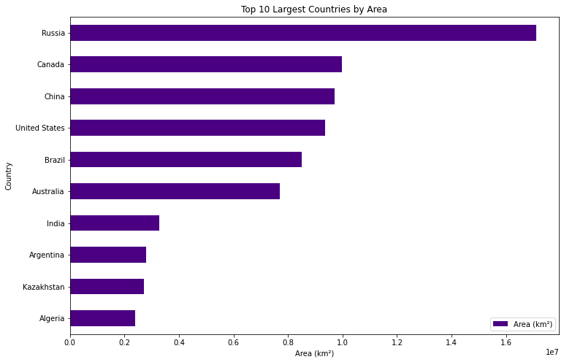
Top 10 Largest Countries by Area
Russia is having the maximum area of country records
Algeria is having less area

Slide 6
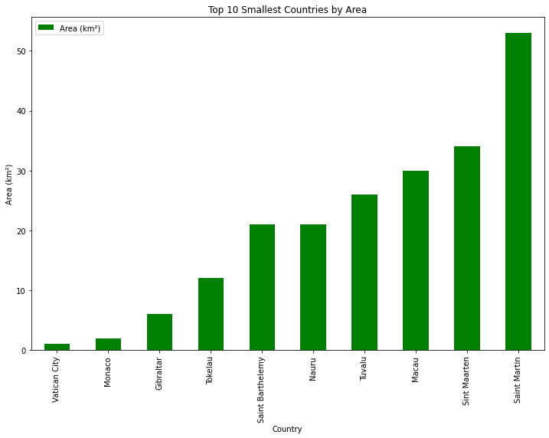
Top 10 Smallest Countries by Area

Slide 7
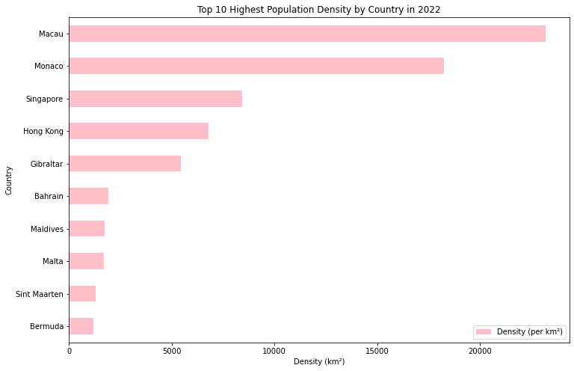
Top 10 Highest Population Density by Country in 2022
Macau is the highest population density by country
Bermuda is the least population density by country

Slide 8
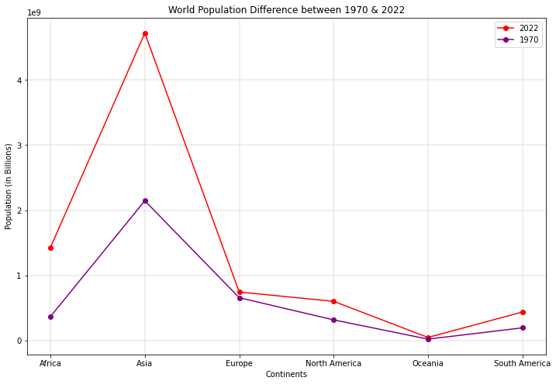
Population Growth from 1970 to 2022
Africa has the maximum population growth
Europe has the least population growth

Slide 9
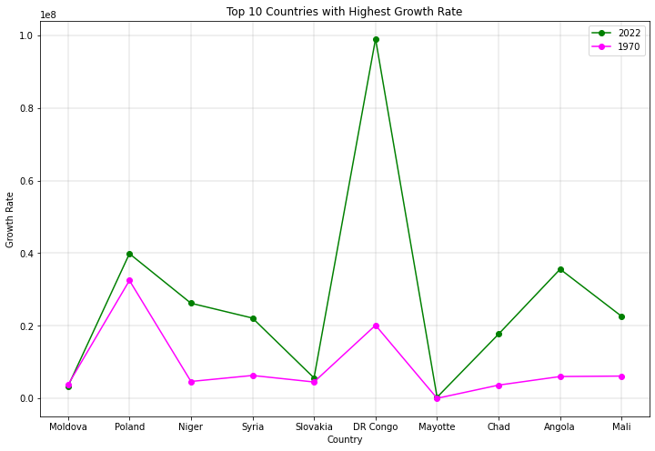
Top 10 Countries with Highest Growth Rate

Slide 10
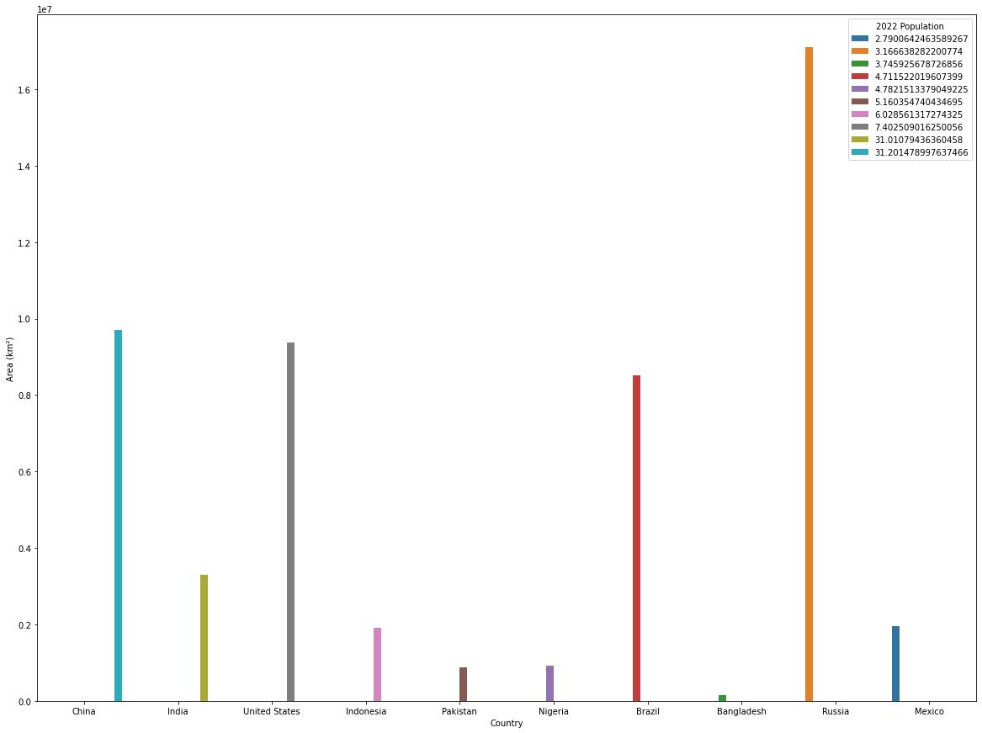
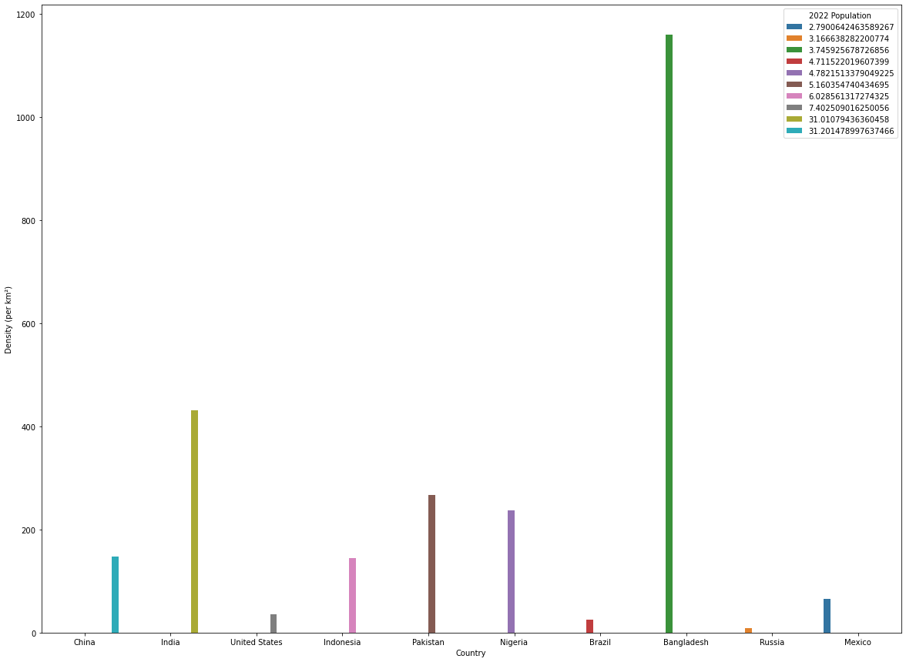
Country vs Population by their Density and Area

Slide 11
Russia is having largest area but less population i.e. it is less denser population country
India is having less area but more population (towards max population with slight differences with China). So, it is most dense population country.
China, USA, Brazil is having almost same Area but population is more in China and least in Brazil.
Per the Density column, Bangladesh appears to be the max density among top 10 countries with population of 3.7%

